Slide 1

Unit One

Slide 2



Slide 3



Slide 4


Slide 5


Slide 6

Looking for a job

Slide 7



Watch the video and answer the questions.
Clip One.
Why is the girl, Ryden Malby, screaming in the end?
fail again, because it’s impossible to be fully prepared for an interview.
2. What is the first problem facing students leaving university?
finding a job; embarrassing jobless period; transition period; temporary job

Slide 8
Watch the video and answer the questions.
Clip Two.
What does Ryden respond to the question “What are you up to” at the party?
I’m interviewing, a lot of opportunities.
What does she say about her situation?
feel like a loser
How do you think students will react if they can’t find a job?
feel like a failure; have a lot of stress; feel anxious / depressed

Slide 9
Watch the video and answer the questions.
Clip Three.
What do you think the students’ parents should do if their children can’t find a job?
get involved and offer help or suggestions
Watch the clip to see if there is any difference between the three fathers’ attitudes and behaviors? Which one do you prefer?
find opportunity; push hard; criticize; encouraging ...

Slide 10

Understanding text
Watch the video and spot the relevant paragraphs in the text by putting their numbers in the table. One video clip may match more than one paragraph.
Video clips | Numbers of the paragraphs
1
2
1
14,15,16
Notes:
www.videolan.org/goodies.html 18:29 14-08-09

Slide 11

Warm-up Activities
Looking for a job after university? First, get off the sofa

Slide 12
Text Organization
Part I
General introduction of the problem (Paras. 1-3)
Part II
Detailed analysis of the problem (Paras. 4-9)
Part III
Advice or solutions for dealing with the problems (Paras. 10-15)
Part IV
Conclusion – (Para. 16)

Slide 13


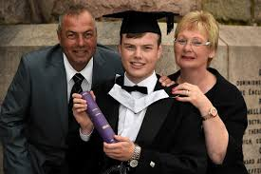
Text Organization
Scenario
In July

Slide 14

Text Organization
Scenario
As the summer break comes to a close and students across the country prepare for the start of a new term.

Slide 15

Text Organization
Scenario
Will he ever get a job?

Slide 16

Text Organization
problem
the graduate
the mother
(Paras. 4-6)
(Paras. 7-9)
big queue, no pressure
aimless dead-end jobs
soft line at the moment
clear about the future
low pay, high demand

Slide 17


Text Organization
advice or solutions
Gael Lindenfield,
a psychotherapist
Parents balance:
positive not making
life too comfortable
It’s a good idea to
get some jobs like bar
work, shelf-stacking.
Better for fathers
to help boys after
a job setback.

Slide 18



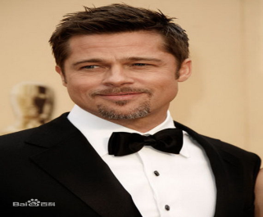
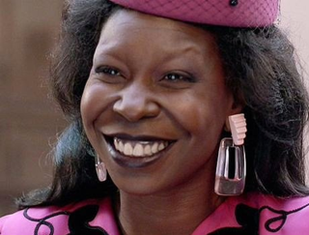
Text Organization
Whoopi Goldberg
Bruce Willis
Brad Pitt
guarded nuclear power plants
stood outside the El Pollo Loco restaurant chain in a giant chicken suit
applied make-up to corpses in a mortuary

Slide 19

Summarising
Text Organization
Listen to the passage and fill in the blanks
with the words you hear.
This text is a newspaper article with individual examples of job searching and problems after graduation. The problems are examined from __________ people’s viewpoints: parents’ attitudes towards their jobless children, students’ quote about looking for jobs, psychologists’ __________ of the viewpoints of parents and advice for dealing with the problems, and the author’s own ___________. In the end the author concludes that if the graduates can not find an _______ job, they can take a temporary one.
different
summary
comments
ideal

Slide 20
Text Interpretation
Look at the sentences and discuss the implied meanings.
click
“Will he ever get a job?” Who is asking this question? What mood does it express?
2. Who describes Generation Y as “rebels without a cause”? Is it a fair description?
3. Jack “walked into the university careers service and straight back out again”.
What does this suggest about Jack’s character?
4. Jack spent the summer “hiding”.
Hiding from what? Why are quotation marks used?
click
click
click

Slide 21
Text Interpretation
Look at the sentences and discuss the implied meanings.
click
5. How is Mrs. Goodwin’s point of view affected by her own personal experience?
6. How is Lindenfield’s point of view affected by her own personal experiences?
7. What would the first two paragraphs have focused on if they had been presented from the point of view of the students rather than the parents?
click
click

Slide 22
Text Interpretation
“Will he ever get a job?”
Who is asking the question? What mood does it express?
The parents are asking the question.
The mood seems to express patience or resignation because the word “ever” suggests that getting a job will take a long time.

Slide 23
Text Interpretation
2. Who describes Generation Y as “rebels without a cause”? Is it a fair description?
This is the writer’s description to indicate that this generation is rebelling against parents or society, but they have nothing particular to rebel against.
This does not seem very fair because the students are trying to find work – it is just that they don’t like their parents nagging them.

Slide 24
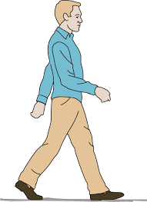

Text Interpretation
3. Jack “walked into the university careers service and straight back out again”.
What does this suggest about Jack’s character?
It suggests that Jack is not very determined. As soon as he saw the queue he left without waiting and without trying to ask about jobs or careers.

Slide 25

Text Interpretation
4. Jack spent the summer “hiding”.
Hiding from what? Why are quotation marks used?
Hiding from the world of work, staying at home and not looking for a job.
The quotation marks tell us that he wasn’t literally hiding, he just spent a lot of time at home.

Slide 26

Text Interpretation
5. How is Mrs. Goodwin’s point of view affected by her own personal experience?
In one way her experience hasn’t affected her attitude. She left school and went immediately to a job (without going to university) and has been working full-time since then and yet she is sympathetic and takes a soft line.

Slide 27
Text Interpretation
6. How is Lindenfield’s point of view affected by her own personal experiences?
Her personal experience was that she worked in a bar before finding her first proper job as an aerial photographic assistant. So she says such work is a great networking opportunity. If new graduates are good at such work and bright, cheerful and polite, they will soon be promoted. Her personal experience thus reflects – or perhaps has created – her point of view.

Slide 28
Text Interpretation
7. What would the first two paragraphs have focused on if they had been presented from the point of view of the students rather than the parents?
The first two paragraphs would have focused on the need for the new graduates to rest for a bit after their hard studies. It is OK for students to relax with the TV or to socialize with friends for a while, then they can start a serious search for employment after that.

Slide 29
Difficult Sentences
click
Those memories of forking out thousands of pounds a year so that he could eat well and go to the odd party, began to fade. Until now. (Para. 1)
This former scion of Generation Y has morphed overnight into a member of Generation Grant. (Para. 2 )
Then I applied for the Civil Service fast stream. I passed the exams, but at the interviews they accused me of being ‘too detached’ and talking in language that was ‘too technocratic’, which I didn’t think possible, but obviously it is. (Para. 5)
For the rest it is 9-to-5 “chilling” before heading to the pub. (Para. 6)
click
click
click

Slide 30
Difficult Sentences
click
5. I went to a comprehensive and I worked my backside off to go to the good university, … (Para 6)
6. … but having worked full-time since leaving school herself, she and her husband find it tricky to advise him on how to proceed. (Para 7)
7. Carry on life as normal and don’t allow them to abuse your bank account or sap your reserve of emotional energy. (Para 11)
8. After that the son or daughter needs to be nudged firmly back into the saddle. (Para 12)
click
click
click

Slide 31
Difficult Sentences
Those memories of forking out thousands of pounds a year so that he could eat well and go to the odd party, began to fade. Until now.
Who paid a lot of money and why?
Parents paid a lot of money for their son to let him eat good food and go to the strange party.
Why are the memories forgotten but now came back?
Parents were proud on seeing the son graduate. But now they were thinking of the money they paid for his study because the son couldn’t find a job.
这时，记忆中每年支付几千英镑，好让儿子吃好、并能偶尔参加聚会的记忆开始消退。但现在，你又不得不再考虑钱的问题。
click
How to translate the sentence into Chinese?

Slide 32
Difficult Sentences
2. This former scion of Generation Y has morphed
overnight into a member of Generation Grunt. (Para 2 )
What does the author mean by “Generation Grunt”?
The son doesn’t seem to communicate much, lies around and doesn’t get a job (or can only do a low status routine job).
The distinguished son of Generation X (of the parents’ generation who worked hard, got jobs, and had good careers and expected their son to do the same) has changed into a member of Generation Grunt.
click
Can you explain the sentence in English?
How to translate the sentence into Chinese?
click
这位属于“千禧一代”的年轻人一夜之间变成了“抱怨一代”的成员。

Slide 33
Difficult Sentences
3. Then I applied for the Civil Service fast stream. I passed the exams, but at the interviews they accused me of being ‘too detached’ and talking in language that was ‘too technocratic’, which I didn’t think possible, but obviously it is. (Para 5)
He applied for a government post. He passed the entrance exams, but he was criticized in the selection interviews: They said he was not personally involved and used the language of a technical expert or high authority. As a recent graduate he probably wanted to show his expertise in his language so he can’t understand this criticism.
What are the meanings of “too detached” and “too technocratic”?
too detached: Not personally involved.
Too technocratic: He used the language of a technical expert or high authority.
click
Can you explain the sentence in English?
然后我又申请参加快速晋升人才培养计划，并通过了笔试。但在面试时，他们说我‘太冷漠’了，谈吐‘太像专家政治论者’。我觉得自己不可能那样，但我显然就是那样的。
click
How to translate the sentence into Chinese?

Slide 34
Difficult Sentences
4. For the rest it is 9-to-5 “chilling” before heading to the pub.
What does it mean by “9-to-5”?
nine-to-five: between nine o’clock and five o’clock, the normal working hours of an office worker:
e.g. She didn’t like working nine to five (or She didn’t like nine-to-five job.)
The others who do not have a routine low status job spend their time casually relaxing and go to pub for a drink in the evening.
Can you explain the sentence in English?
click
How to translate the sentence into Chinese?
click
其余的则都是朝九晚五地“无所事事”，晚上则去酒吧喝酒打发时间。

Slide 35
Difficult Sentences
5. I went to a comprehensive and I worked my backside off to go to the good university. (Para 6)
What does it mean by “work my backside off”?
Informal way expressing “work very hard”.
Can you explain the sentence in English?
click
He went to a school for students of all abilities (not to a special school for academic students) and so he had to work very hard to enter a good university.
How to translate the sentence into Chinese?
click
我上的是综合学校，我拼命读书才考上了一所好大学。

Slide 36
Difficult Sentences
6. … but having worked full-time since leaving school herself, she and her husband find it tricky to advise him on how to proceed. (Para 7)
click
Can you explain the sentence in English?
The mother has always had a full-time job (presumably the father is also working full-time), so she does not have relevant personal experience. For her, it is difficult to give advice.
她自己中学毕业后一直都在工作，所以她和她的丈夫发现，建议儿子如何继续找工作是件很棘手的事情。
How to translate the sentence into Chinese?
click

Slide 37
Difficult Sentences
7. Carry on life as normal and don’t allow them to abuse your bank account or sap your reserve of emotional energy. (Para. 11)
What does it mean by “sap your reserve”?
“sap the reserve of something” means “use up sth.”
Parents should live as usual. They should neither let their children spend their money unnecessarily, nor let the problem take away all their emotional energy.
click
Can you explain the sentence in English?
How to translate the sentence into Chinese?
click
父母要维持正常的生活，不要让孩子随便用你们的银行账户或者榨干你们的情感能量。

Slide 38
Difficult Sentences
8. After that the son or daughter needs to be nudged firmly back into the saddle.
What does it mean by “saddle”?
It means in a position in which you have power or authority.
e.g. He always has to be in the saddle, controlling everything.
Then the parents should gently push their children firmly so that the children get back into control of their lives.
click
Can you explain the sentence in English?
How to translate the sentence into Chinese?
等他们缓过来之后，父母就该坚决要求孩子继续求职。
click

Slide 39

Words & Expressions
galvanize vt. to shock or affect sb. enough to produce a strong and immediate reaction 使振奋；刺激
The U. S. has, over the past year, exploited this tension to galvanize the rest of East Asia against China and under U.
Some environmentalists have hoped that fiction
could galvanize action on climate the way other books
have spurred social and political movements.

Slide 40

Words & Expressions
fraught a. showing or producing tension or anxiety； filled with 令人担忧的；担心的，忧虑的；充满…的
Next week will be particularly fraught as we've just lost our secretary.
Efforts to stop nuclear proliferation look almost as fraught as the climate negotiations.
Although his peace policy received broad support, the
cause for peace was still fraught with difficulties and pain.

Slide 41
clutch
Words & Expressions
v. grip, grasp: to hold something tightly, closing your fingers around it.
v. grab: to quickly and suddenly take hold of sb./sth.
n. (复数) control
power or
influence that
sb. has
clutch

Slide 42
Words & Expressions
Replace “clutch” with correct words in the box.
grip; grasp; control; grab
She was clutching a bottle of wine.
grip; grasp 紧紧攥着
2. The man clutched at a pillar (立柱) for support.
grab 突然抓住立柱作为支撑
3. The bad news clutched at Mary’s heart.
grab 突然感到揪心
4. She will have the man in her clutches soon enough.
control 控制在手中

Slide 43

Words & Expressions
fork out: (infml) to spend money on sth., especially when you do not want to （尤指不情愿地）付出，花费
I've stayed late at work and missed the last bus home, so I've had to fork out for a taxi when I'm dangerously close to payday.
Before the UN introduced a ruling on cybersquatting last year, corporations and individuals were being forced to fork out staggering sums to buy the rights to an address.

Slide 44

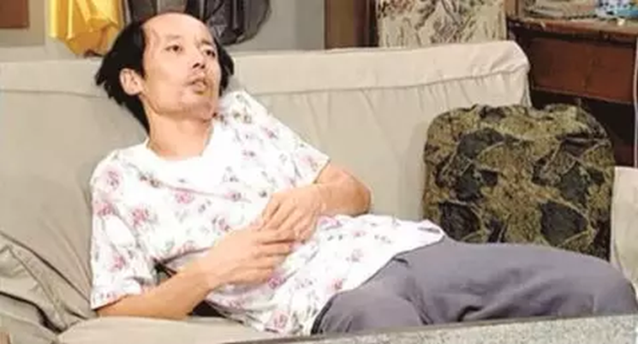
Words & Expressions
slump: v. fall or sit down somewhere heavily, for example, because you are very tired or you feel ill. 瘫倒; (因劳累或生病等) 跌坐
Ge You Slouching

Slide 45
Words & Expressions
Lonnie slumped down again on the steps, his hands falling between his outspread legs and his chin falling on his chest.
Thomas sat slumped in his chair, humming tunelessly and tapping an annoying rhythm on his glass with his fork.
You're not likely to suffer from sophomore slump or general boredom while you're studying in a different learning environment.
After graduation, you will not feel like you're the only person going through a post-college slump.

Slide 46
Words & Expressions
Government popularity in Scotland has slumped to its lowest level since the 1970s.
2. There is more unemployment or underemployment of labour and capital equipment in the slump than in the boom.
3. A college diploma has long been the ticket to a good job,
but the deepest economic slump in decades has dampened the dreams of many U. S. college seniors.
decrease suddenly
depression

Slide 47

Words & Expressions
grunt n. & v. to make a short low sound to indicate disgust, approval or disapproval （表示厌恶、不满等的）咕哝声，嘟哝声
At home he grunted "eh?" across the newspaper to his commentary wife.
Lonnie listened to the grunting of the pigs as they walked up the driveway towards the big house.

Slide 48
Words & Expressions
grunt
say in a low & rough voice, esp. when not interested in others
murmur
say with soft & low voice, difficult to hear (默默地说着)
mumble
say quietly and unclearly so others can not understand (含糊地说)
whisper
say quietly using breath rather than voice
mutter
say quietly, esp. when annoyed

Slide 49
Words & Expressions
Pair work. Fill in the blanks with proper words.
murmur grunt mumble whisper mutter
mumbled
The man could only __________ an apology for the mistake he made.
The child ____________ something in its sleep.
He just __________ something I didn’t catch and went on reading his book.
“Why do I have to do all the work?” She ___________.
You don’t have to ___________. There is no one around.
murmured
grunted
muttered
whisper

Slide 50

Words & Expressions
revert v. ( ~ to) to return to a previous state or way of behaving, often one that is not good 恢复到（原状或原来的行为方式）
Jackson said her boss became increasingly depressed and reverted to smoking heavily.
But the energy source to which most economies will revert if they shut down their nuclear plants is not wood, water, wind or sun, but fossil fuel
Similar words：avert; divert; convert; retrovert

Slide 51

Words & Expressions
in the same boat: in the same difficult or unpleasant situation 处于同样的糟糕境地
1. Our common interests and common challenges have put us in the same boat.
2. In his book, Hansen presumes that China and the United States would agree to a global carbon tax "once both countries realize they are in the same boat and will sink or survive together."

Slide 52

Words & Expressions
chill (out) vi. to pass time without a particular aim or purpose, esp. with other people; relax completely or not allow things to upset you 消磨时光；放松
I’m sick of studying at weekends. I just want to chill out.
As you begin to move into your "nightly routine," your mind will get the signal that it's time to chill out and tune down, dialing down stress hormones and physiologically preparing you for sleep.

Slide 53
Words & Expressions
Comprehensive a. including all elements or aspects needed dealing with
Work in pairs and translate the following into Chinese.
comprehensive review
comprehensive collection of works
全面回顾
内容广泛的作品集
comprehensive study
comprehensive guide
综合性研究
综合指南
comprehensive insurance
comprehensive school
(汽车)综合险
综合中学（英国）

Slide 54

Words & Expressions
dead-end a.
1. lacking opportunities especially for advancement 没有前途的
e.g. It is a dead-end job; I just work in the stores and there’s absolutely no prospect of promotion.
我的工作没有前途，我只是在仓库工作，绝对没有 晋升的指望。
2. closed at the end, leading nowhere 没有出路的
e.g. One of my friends said he chased me all the way into a dead-end alley, and that I would just disappear without a trace.
我一个朋友说他一路追我进了一个死胡同，可是我 就无影无踪地消失了。

Slide 55




Words & Expressions
come full circle: to end in the same situation when you start even though there has been changes in time
turn / go full circle =兜了一圈回到原位
Match the sentences with the pictures.
Sooner or later, fashion comes full circle. ( )
The discussion has come full circle. Let’s not waste time. ( )
Notes:
Zhai Zhigang debuts spacewalk: english1.cri.cn/3126/2008/09/27/... 11:19 24-07-09

Slide 56
Words & Expressions
take a soft/hard line: to take a moderate or flexible /firm or uncompromising policy or position, as on a political issue 采取温和/强硬的态度
e.g.
1. The president took a very soft/hard line against radicalism.
总统采取温和/强硬的反激进主义政策。
2. The delegation is under pressure from US companies to take a hard line with the country over the value of its currency and market access.
美国企业界向代表团施压，希望美国在该国货币汇率和市场准入方面对中国采取强硬路线。

Slide 57
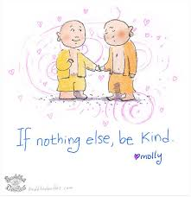
Words & Expressions
if nothing else: used for mentioning what you think may be the only good aspect of sth. or the only good reason for doing sth. 如果没有意外；撇开其他不谈; 至少
e.g.
Music taste can often say a lot about a person’s outlook on life and if nothing else, it’s an excellent conversation starter.
If nothing else, this awful report helps to solve a number of lingering mysteries concerning the crisis.

Slide 58
Words & Expressions
strike the right note: to say or do what is especially appropriate 说话说到点子上；做事做得恰到好处
e.g.
1. Her speech appeared to strike exactly the right note.
她的演说看来说到了点子上。
2. The headmaster had failed to strike the right note in his speech on discipline and the pupils continued to behave in their own way.
校长有关纪律的讲话并没奏效，小学生们还是我 行我素。

Slide 59
Words & Expressions
talk through: to discuss a plan or a situation in a detailed way 详细讨论
e.g.
1. He had to talk it through with his wife.
2. He came into my office recently, as have many of the grown boys I've seen over the years, to talk through the biggest transition of his life.
3. Why don't we talk through what we need to do this week before we get into expectations?

Slide 60
Words & Expressions
Cf: talk sb. through sth.: to explain sth. to sb. in detail so that they understand it 给某人详细解释
e.g.
1. The technical support staff will talk you through any difficulties you have with the software.
技术支持人员将给你详细讲解使用软件时遇到的困难。
2. I can talk you through the application form.
我可以详细告诉你如何填写申请表。

Slide 61
Words & Expressions
go for sb./sth.: to be true or relevant for sb. or sth. 适用于
e.g.
1. We expect you boys to behave yourselves, and the same goes for the girls.
我们希望你们男孩子规规矩矩，当然对女孩也希望如此。
2. It is illegal to dishonour reservations; that goes for restaurants as well as customers.
拒付预订是违法的；这既适用于顾客，也适用于饭店。

Slide 62
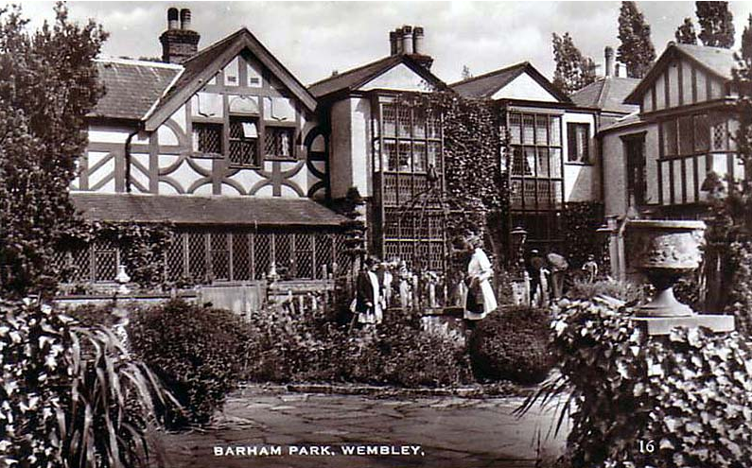
Words & Phrases
Cultural Notes
Middlesex: a former county of southeast England, situated to the north west of London. In 1965 it was divided between Hertfordshire, Surrey, and Greater London. 米德尔塞克斯郡（英国英格兰原郡名）

Slide 63
Cultural Notes
Honors Degree
Put the sentences in order according to the meanings:
Most people get a second.
Traditionally, in the British university system, BA (文学学士) and BS (理学学士) are awarded in different categories: a first class degree (I), a second (IIi or IIii called “a two one” and “a two two”), a third (written III) and a pass degree.
There are also ordinary degrees with more general courses of study without these categories.
Key:
2 1 3

Slide 64

Cultural Notes
Generation Y and Grunt
Work in pairs and answer the question. How to name the generations and characterize them?
Years of birth | Names | Characteristics
1946 – 1960 |  | Born in the great increase of births
1960 – 1980
1980s – 1990s
Baby boomers
independent, informal, entrepreneurial
Generation X
Generation Y or
Millennial Generation
spoilt by parents; have structured lives; teamwork

Slide 65
Cultural Notes
2. Why is Generation Y is also called Generation Grunt?
Complete the passage with the words in the box.
express children available experience
Generation Grunt is an ironic name referring to repetitive, low status, routine or mindless work – this may be the only work ____________ to some graduates, who may have to take very ordinary jobs to get _____________.
“Grunt” also refers to coarse behavior or bad manners and to the deep sound that is made by a pig. When people “grunt” they __________ disgust but do not communicate with words – this may be how the parents of new graduates think their ___________ communicate with them!
available
experience
express
children

Slide 66
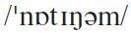

Words & Phrases
Cultural Notes
Nottingham 英国诺丁汉大学
The University of Nottingham is a public research university based in Nottingham, United Kingdom, with further campuses in Ningbo, China and Kuala Lumpur, Malaysia. It is considered among the top ten leading universities in the UK, and has been described by The Times as “the nearest Britain has to a truly global university” and “a prime alternative to Oxbridge”.

Slide 67
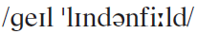

Words & Phrases
Cultural Notes
Gael Lindenfield 盖尔·林登费尔德（英国作家兼心理治疗学家）
Gael Lindenfield is a psychotherapist and the UK’s leading confidence and self-help expert, a specialist in improving self confidence, assertive communication, anger management and emotional healing.
She is also the internationally best selling author of 21 ground-breaking books, which have been translated into 33 languages.

Slide 68
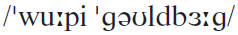
Words & Phrases
Cultural Notes
Whoopi Goldberg 乌比·戈德堡（美国女演员）
Whoopi Goldberg (1955— ) is an Oscar-winning American actress, singer-songwriter, political activist, and talk show host.
Goldberg made her film debut in The Color Purple playing Celie, a mistreated black woman in the Deep South. She received a nomination for the Academy Award for Best Actress and won her first Golden Globe Award for her role in the film. In 1990, she starred as Oda Mae Brown, a psychic helping a slain man find his killer in the blockbuster film Ghost. This performance won her a second Golden Globe and an Academy Award for Best Supporting Actress.

Slide 69

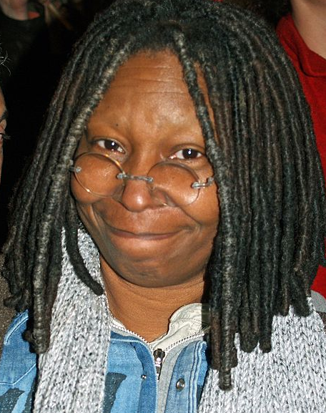
Words & Phrases
Cultural Notes
Whoopi Goldberg

Slide 70
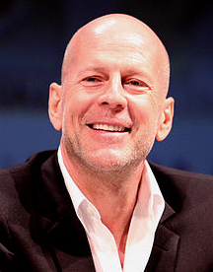
Words & Phrases
Cultural Notes
Bruce Willis 布鲁斯·威利斯（美国男演员）
Bruce Willis (1955— ) is an American actor, producer and musician. His career began in television in the 1980s and has continued both in television and film since, including comedic, dramatic, and action roles. He is well known for the role of John McClane in the Die Hard series, which were mostly critical and uniformly financial successes. He has also appeared in over 60 films, including box office successes like Pulp Fiction, Sin City, 12 Monkeys, The Fifth Element, Armageddon, and The Sixth Sense.
Notes:
Die Hard 虎胆龙威 Armageddon世界末日

Slide 71
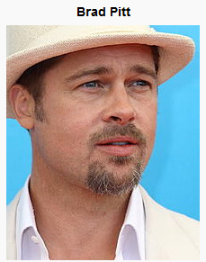
Words & Phrases
Cultural Notes
Brad Pitt 布拉德·皮特（美国男演员）
Brad Pitt (1963— ) is an American actor and film producer, whose films include Troy, Mr. and Mrs. Smith and The Curious Case of Benjamin Button. Pitt has received two Academy Award nominations and four Golden Globe Award nominations, winning one. He has been described as one of the world’s most attractive men, a label for which he has received substantial media attention.
Notes:
The Curious Case of Benjamin Button返老还童

Slide 72
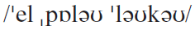

Words & Phrases
Cultural Notes
El Pollo Loco
（美国连锁餐馆名）
El Pollo Loco is a fast-food restaurant chain specializing in Mexican grilled chicken, headquartered in Costa Mesa, California. “El Pollo Loco” is Spanish for “The Crazy Chicken”.
Their main dish is pollo asado, a grilled marinated chicken. Over time, the chain has expanded into burritos and salads, and serves items that compete with Taco Bell, Del Taco and other Mexican-style restaurants.

Slide 73
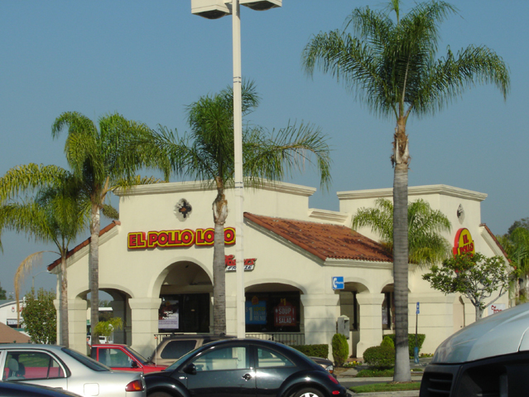
Words & Phrases
Cultural Notes
A typical El Pollo Loco restaurant

Slide 74

Word formation Compound nouns
noun + noun = compound nouns
The first noun plays the function of adjective to describe the second noun.
Look for more compound nouns in the text:
graduation photo; the university careers service; cutoff point; Christmas work; career consultations; job setback; Hollywood stars; nuclear power plants; restaurant chain

Slide 75

Work in pairs. Match the two parts:
1. A room where an interview is held;
2. A degree which is awarded a first class;
3. A discount for students;
4. A period spent in training;
5. A ticket for a plane journey;
6. Work in hospital;
7. A pass which allow you to travel on buses
Student discount
hospital work
a plane ticket
an interview room
a first-class degree
a training period
a bus pass

Slide 76
Word formation Noun phrase
Write the noun phrase which mean:
a career which is rewarding from the financial point of view
a financially rewarding career
2. legislation which has been introduced recently
recently introduced legislation
3. instructions which are more complex than usual
unusually complex instructions
4. an institution which is orientated towards academic
academically orientated work

Slide 77
Word formation Noun phrase
Write the noun phrase which mean:
5. work which makes physical demands on you
physically demanding work
6. information which has the potential to be important
potentially important information
7. candidates who have been selected after a careful procedure
carefully selected candidates
8. a coursebook in which everything has been planned beautifully
a beautifully planned textbook

Slide 78
Clauses introduced by than
than + be + adj.
than + be + noun phrase = than + noun phrase + be
= than + pronoun + be
Rewrite the sentences using clauses introduced by than
She’s experienced at giving advice. I’m more
experienced.
She’s less experienced at giving advice than I am.
I am more experienced at giving advice than she is.
2. You eat too much chocolate. It isn’t good for you.
You eat too much chocolate than is good for you.

Slide 79
Clauses introduced by than
After-class Task
Rewrite the sentences using clauses introduced by than
3. She worked very hard. Most part-timers don’t work
so hard.
She worked harder than most part-timers do.
4. You have arrived late too many times. That isn’t
acceptable.
You have arrived late more times than is
acceptable.
5. I don’t think you should have given so much
personal information. It isn’t wise.
I think you have given more personal information
than is wise.

Slide 80


After-class Task
A Good Read is one of BBC Radio 4's longest-running programmes; in it two guests join the main presenter to choose and discuss their favourite books. Sue MacGregor stepped down in 2010 as the programme's longest-serving presenter (seven years). Her successor is the writer, broadcaster and academic Harriett Gilbert, who took up the reins in May 2011. Previous presenters have included the novelist Louise Doughty 1998 to 2001.
The programme began in 1977
Books worth reading.

Slide 81
After-class Task
Our class began to produce a ten-minute TV programm ________ to introduce your favorite books for reading;
Each group as the panelists collectively choose one favorite book for your introduction;
The program should be interesting and appealing, with book introduction about
the book title, writer, contents,… and the reasons for choosing it.
The book introduced is on the reading list of most of the classmates is the winner!
Books worth reading.

Slide 82


